Slide 1


CarRento Mobile Application
CMP7163 Advanced Mobile Computing Project 2024/5
Submitted By :
Maddela Harsha Sree (24171038)
Submitted To :
Prof Harjinder Singh

Slide 2
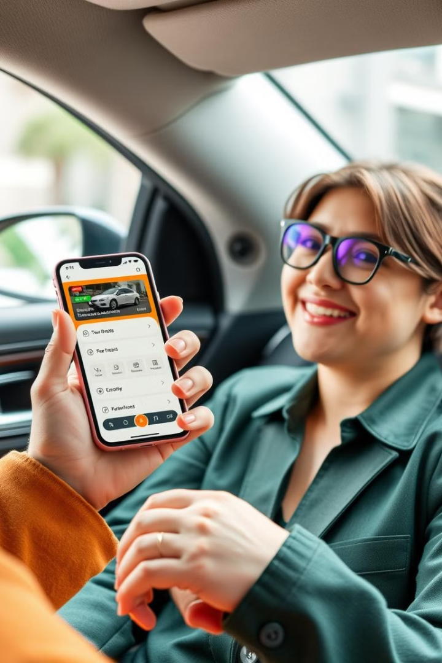
CarRento App Overview
The CarRento is a car rental Mobile Application where a user can easily search for a car, book and rent a car based on his preferred location and particular date and time.
The user can also save his favorite car on the device so he can re-rent the car in the future.
The user will find this app easy to rent the car based on the current location or they can manually enter the location and select the date and time when they want to rent the car.
If the user login, then he can find the cars that he saved and he can also view the previous renting of the cars.
The user can select the cars after seeing the car features and description and the user can always go back and change the car.
There is a free cancellation feature if the user have change in plan or change in mind the user can cancel the booking with in 24 hours where they will get full refund.

Slide 3
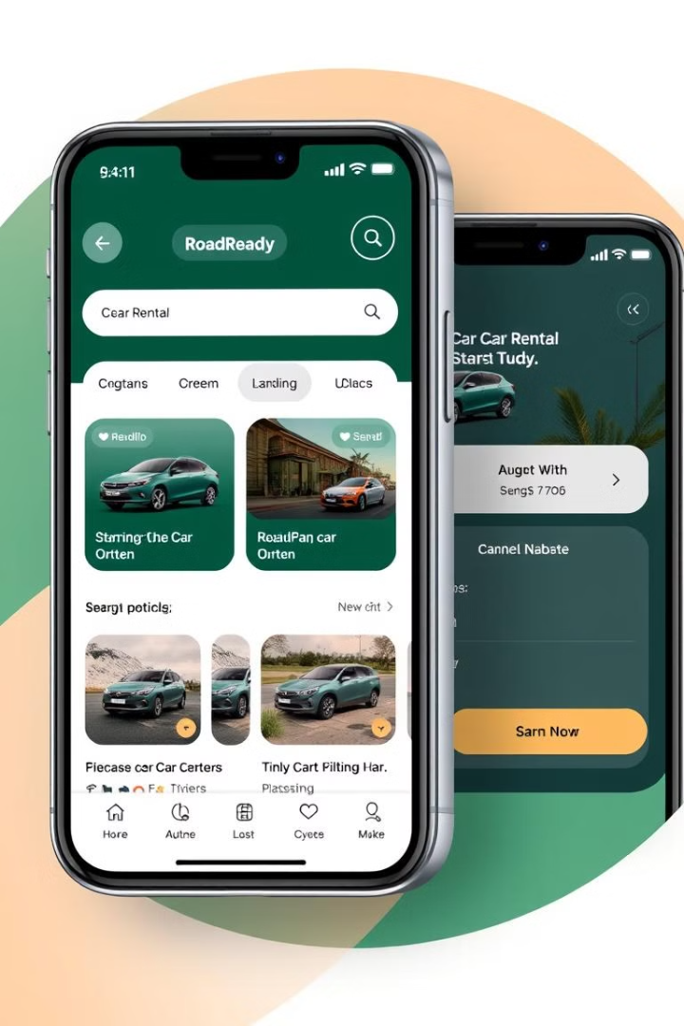
Key Features / Framework of the App
Search : Users can use the GPS to locate their current location, or they can manually enter the pickup and return location.
Save Favorite Cars : Users can save the cars that they like according to there preference and comfort in the device for future use.
Rent History : Users can see their previous history of there rented cars and they can use that to book the same car if they want.
Date and Time : Users can select the date and time from when they want to rent a car and return it.
Profile : User can get the contact support if they face any issues.

Slide 4
Key Features / Framework of the App
Front-end : we are using the React Native ( Javascript ) so we use it for cross-platform for both android & IOS.
Restful API : Using a third party Webservice so we can get the data related to the car, previous history, booking.
Database : We are using MongoDB for Database server.
Backend : Node.js as the Backend service.
Data Persistence : To store the data On-device we are using the Local SQLite of Reactnative where the user can save their favorite cars on their device

Slide 5
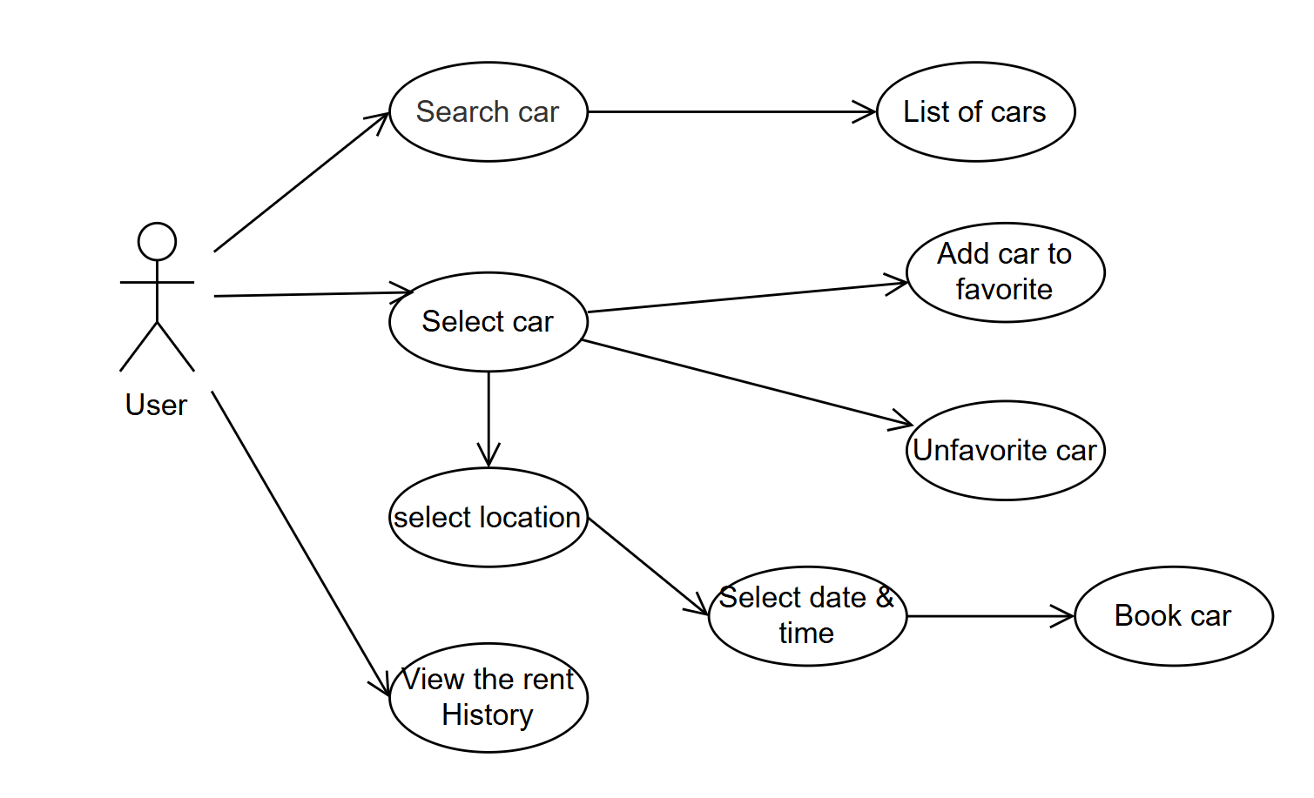
App Requirements
Use case Diagram for the App

Slide 6
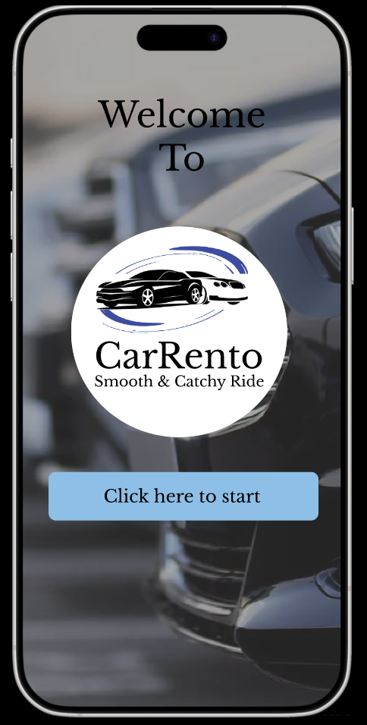
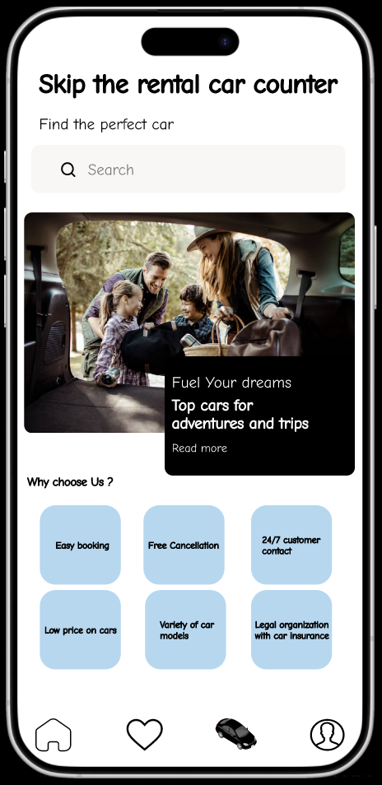
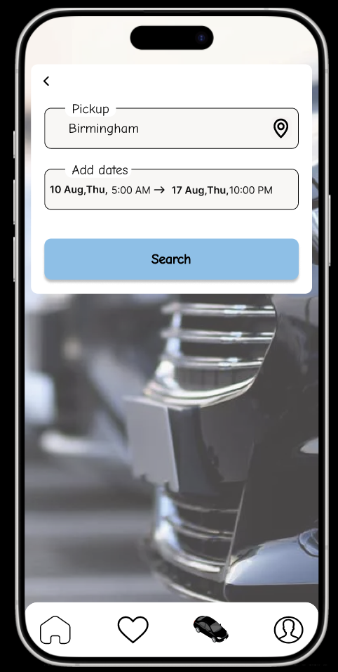
UI Design for the App

Slide 7
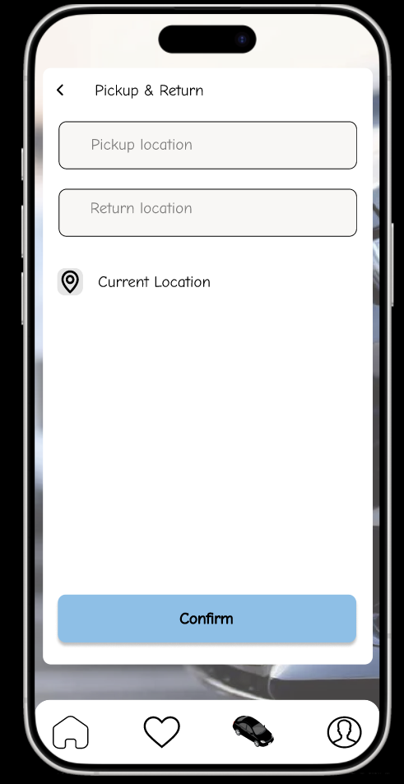
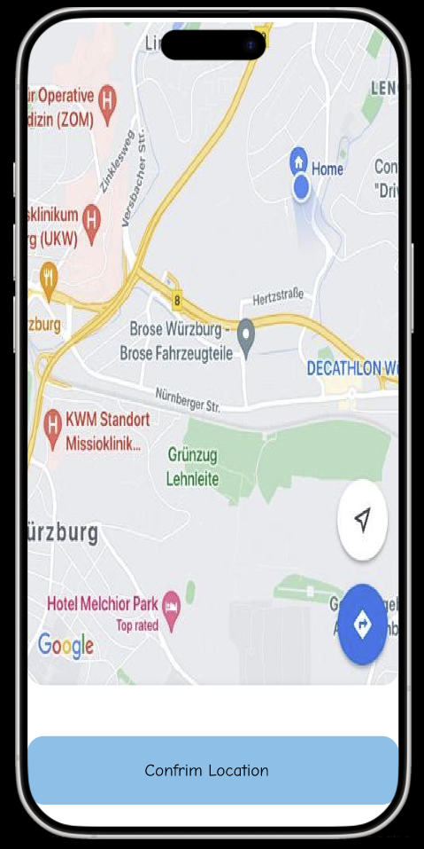
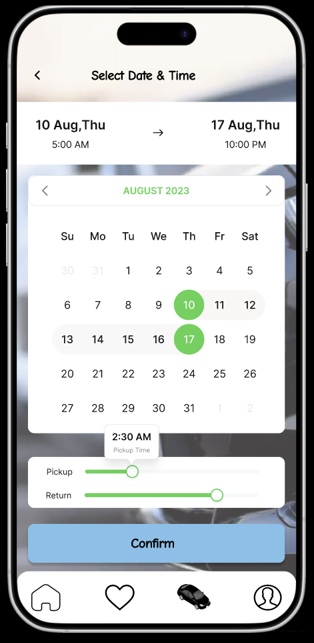
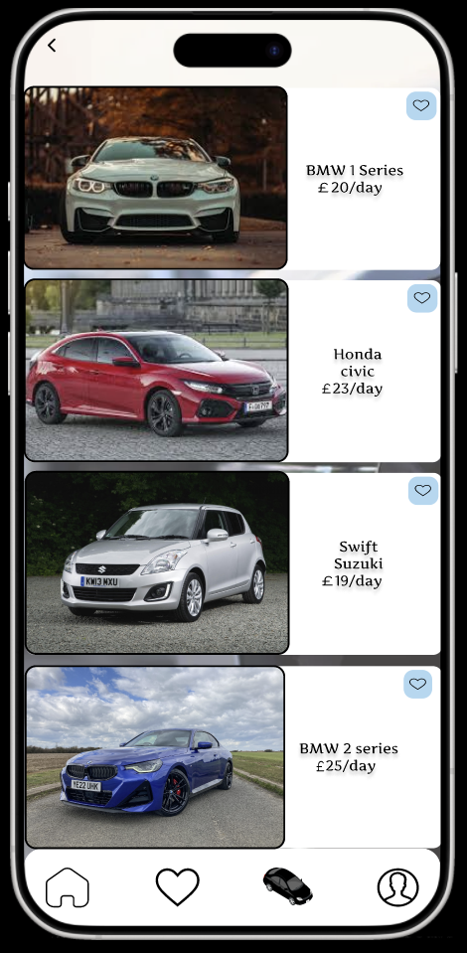
Enter the location manually
Use current location

Slide 8
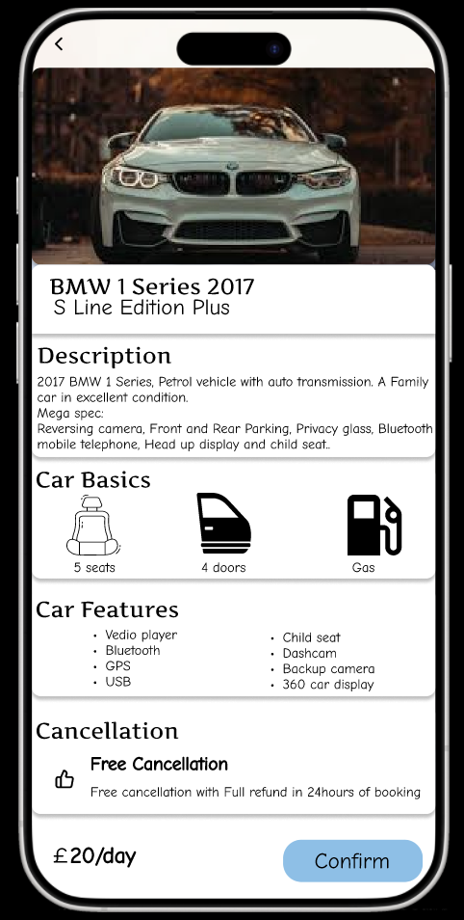
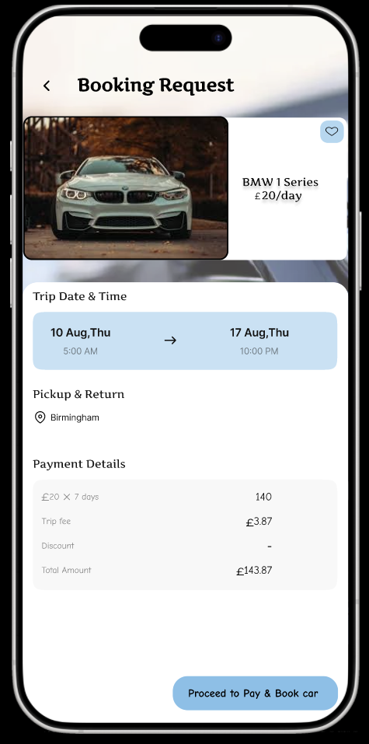
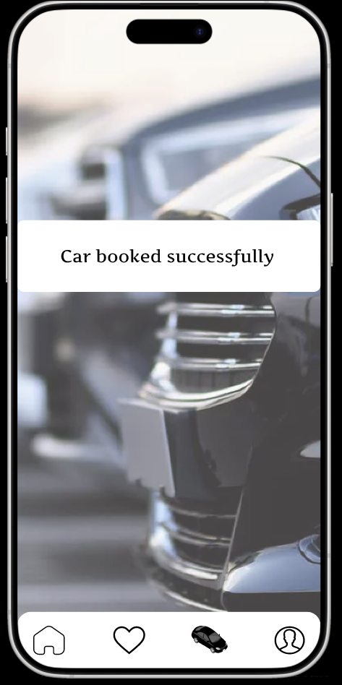

Slide 9
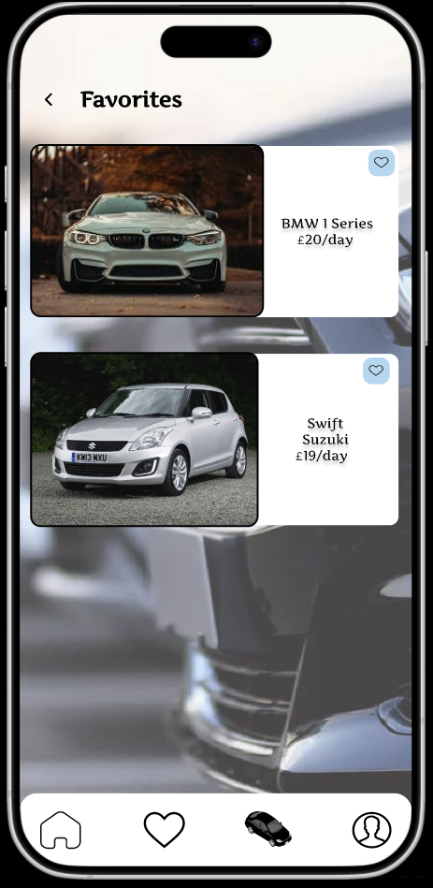
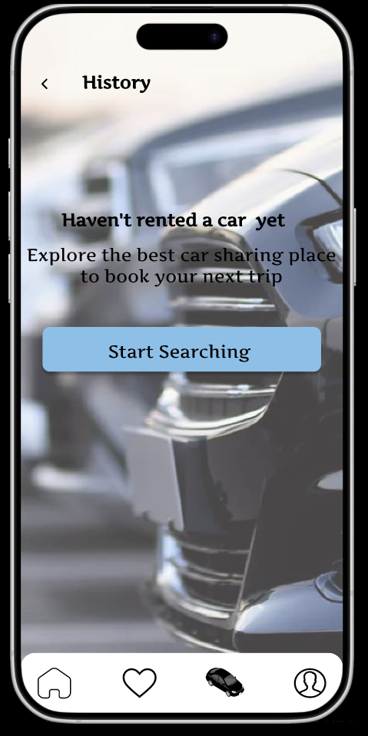
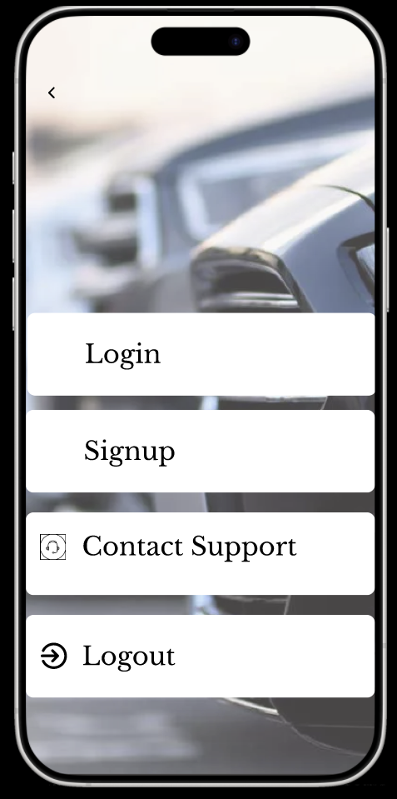

Slide 10
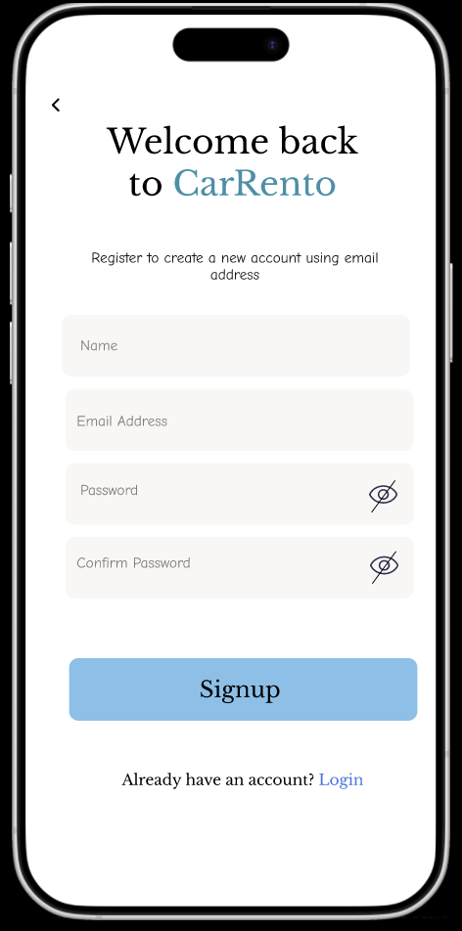
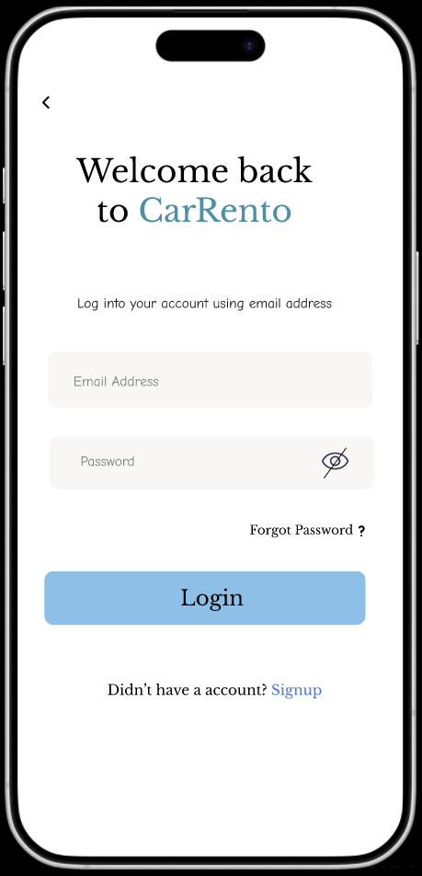

Slide 11
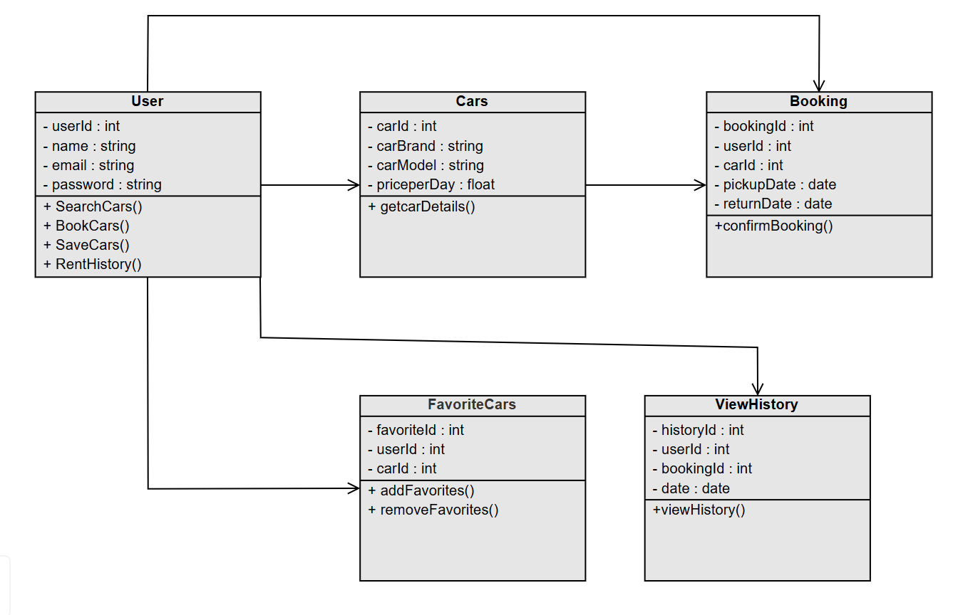
Overall App Design
Class Diagram for the App

Slide 12
UI Design Flow Explanation
This Design flow will explain the process when the user opens the application. The user needs to login or Signup into the mobile application.
After successful logging, the user will search for the car to rent by manually entering the location or he can use the GPS which can detect the current location.
The user will give the pickup location and return location for the car and then he select the date and time which is preferrable to the user to rent the car and click the search button.
Upon pressing the search button, a list of cars with different models which are available will be displayed on the screen. From the displayed cars the user will select a car.
After selecting the car, the user can see the features and description of the car and its cost per day. If he likes he can confirm to book, if not the user can always go back and select the other car according to their needs and preferences.
After the successful booking of the car the user will receive a mail which contains the booking details. The user can also go to the history section to see the previous rent history of the cars.
If the user liked the car he can always save, them to his favorites and re-rent the car for the future trips.

Slide 13
On-Device Data Persistence
Will use the SQLite :
Which works good for both Android and IOS.
To store the data of the saved favorite cars, rent history of the cars in a local storage so that the user can still be able to see the cars that he saved in offline mode.
Will use the Redux:
Which helps in moving the data across multiple screens.
Data consistency across the different components of the app.
Global state management of the app.

Slide 14
Off-Device Data Source
Restful Webservices
Will use the Car RESTful Web Service to get the data
Example Request URL to search for the cars.
https://booking-com15.p.rapidapi.com/api/v1/cars/searchCarRentals
Example Response in Json Format
{
carId:"691524961"
carBrand:"Peugeot"
carModel:""Peugeot 3008 "
doors:"4"
Transmission:"Manual"
aircon:1
seats:"5“
description: "The car have a rear front camera and back camera and 360-degree display in front of the gear, quality speakers and child seat"
}

Slide 15
Additional Framework
Use the GPS Location button to get the current location to get the cars that are available nearby.
Conclusion and Challenges
Ensuring the smooth Integration of the API while implementation.
Saving the favorite cars and removing the according to the user preference.
Handling the large datasets for the rent history and displaying list of cars without any issues.
Ensuring that the implementation will work both in Android & IOS
The prototype of the Mobile application:
https://www.figma.com/proto/uACBKUe4vraUHWhi85EoAE/CarRento?node-id=48-2093&t=zTiVZAqhwZKPdEOP-0&scaling=scale-down&content-scaling=fixed&page-id=0%3A1&starting-point-node-id=48%3A2093&show-proto-sidebar=1

Slide 16
Thank you

